Slide 1

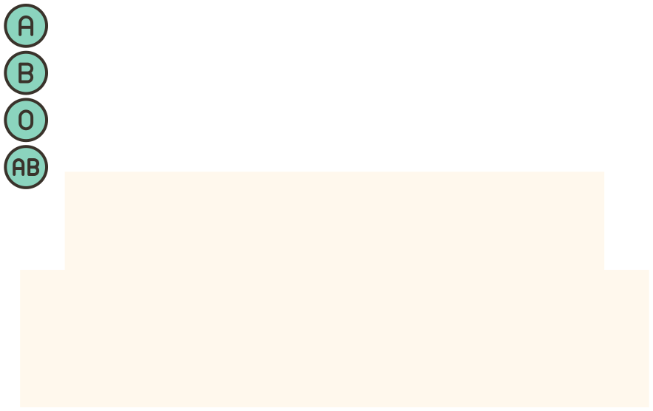














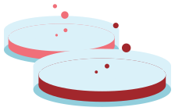




TEAM 5
BLOOD GROUP IDENTIFICATION

Slide 2



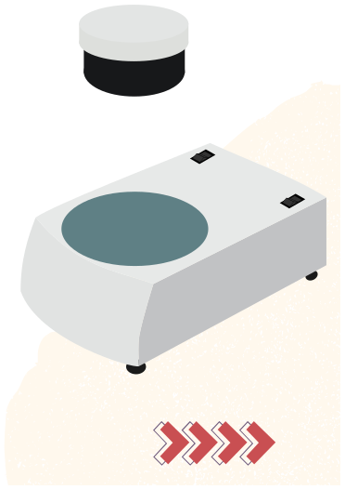



Introduction Project Overview Features and Functionality Milestones Achieved Technical Workflow Screenshots of the Application Live Demonstration Challenges and Solutions Future Enhancements Conclusion Team Members
AGENDA

Slide 3




INTRODUCTION
The Blood Group Identification System is an innovative, Python-based computer vision application utilizing OpenCV to automatically determine an individual's blood group from uploaded images. By applying advanced image processing techniques and predefined conditions, this system accurately detects and classifies ABO and Rh blood types. With its intuitive interface and rapid analysis, this tool facilitates efficient and accurate blood group identification, supporting medical professionals, researchers, and individuals in making informed decisions regarding blood transfusions, medical treatments, and personalized care.

Slide 4
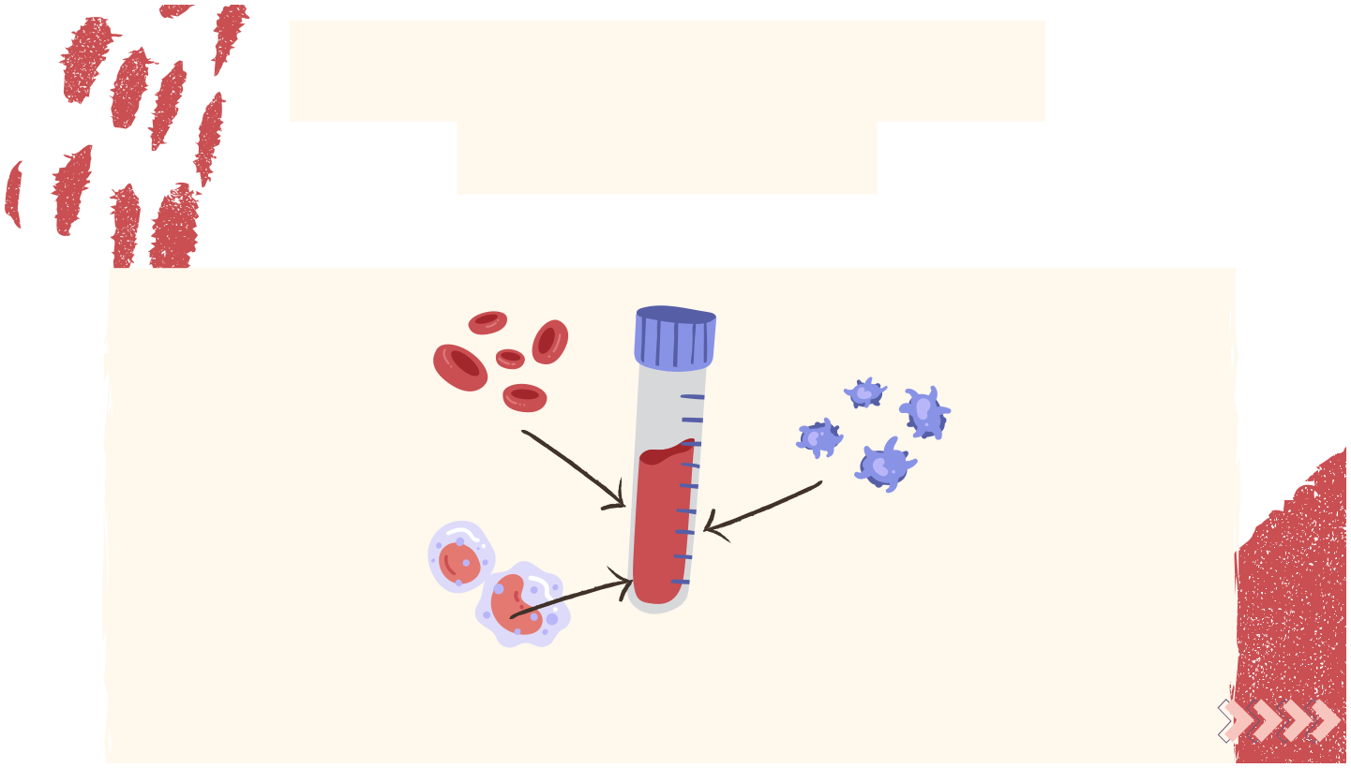
IMPORTANCE OF BLOOD GROUP IDENTIFICATION
Blood groups play a critical role in
Blood transfusions and organ transplants.
Research on genetic and disease predisposition.
Medical treatments and emergency care.
Traditional methods can be time-consuming and prone to human error.

Slide 5



PROJECT OVERVIEW
CUSTOMER FEATURES
CREATE A NEW USER ACCOUNT TO ACCESS THE APPLICATION LOGIN WITH YOUR USERNAME AND PASSWORD UPLOAD IMAGE OF BLOOD SAMPLE FOR ANALYSIS OUTPUT DISPLAYS RESULTS OF THE DETECTED BLOOD GROUP

Slide 6
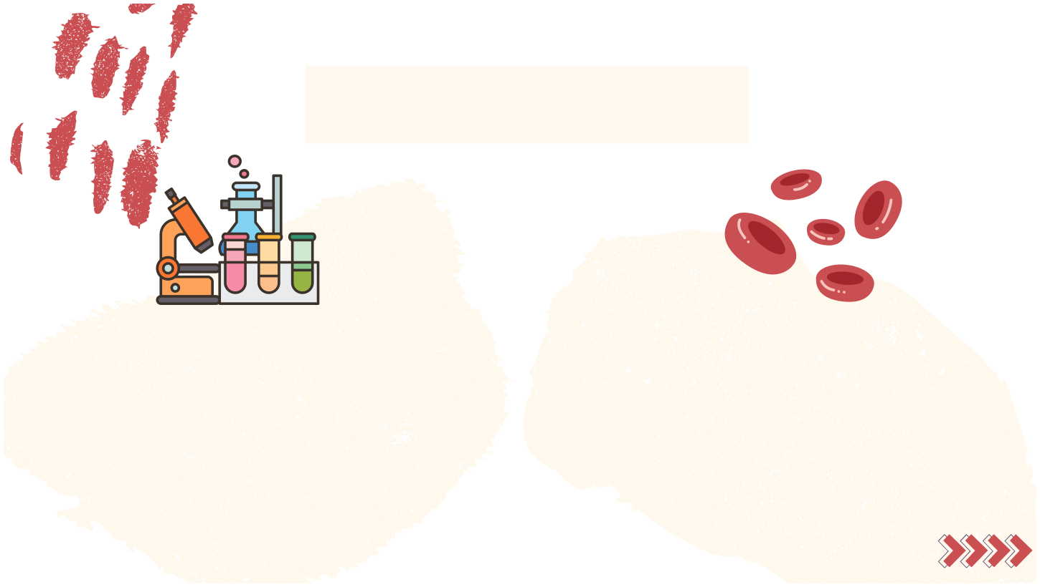
TECHNICAL WORKFLOW
Image Upload: User uploads a clear blood sample image through the profile page. Image Processing (OpenCV): Noise reduction and edge detection. Morphological transformations.
Blood Group Identification: Predefined conditions applied for classification. Output Display: Uploaded image, morphological image, and blood group result.

Slide 7

HISTORY OF BLOOD GROUP IDENTIFICATION
Blood group discovery:
Discovered by Karl Landsteiner in 1901. ABO and Rh systems are the most significant.
Advancements:
Manual methods: Slide test, tube method. Automated methods: computer vision.

Slide 8

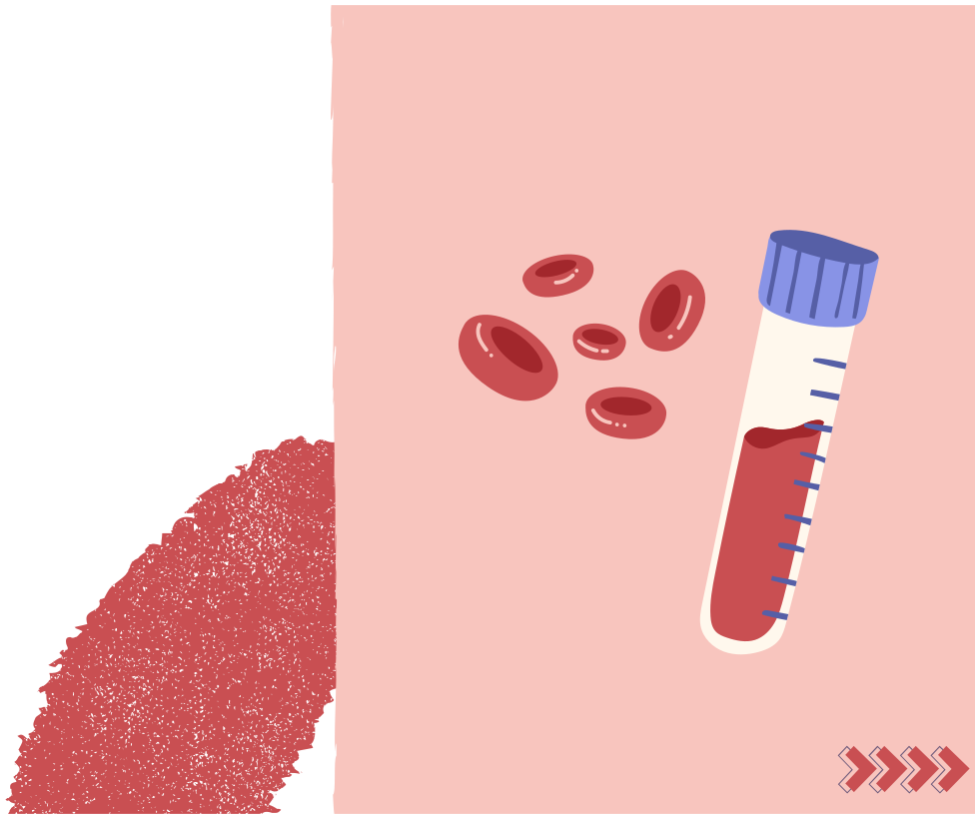
MILESTONE - 1
The system allows users to visit the website and can see information about the web page, the registration page and the login page

Slide 9

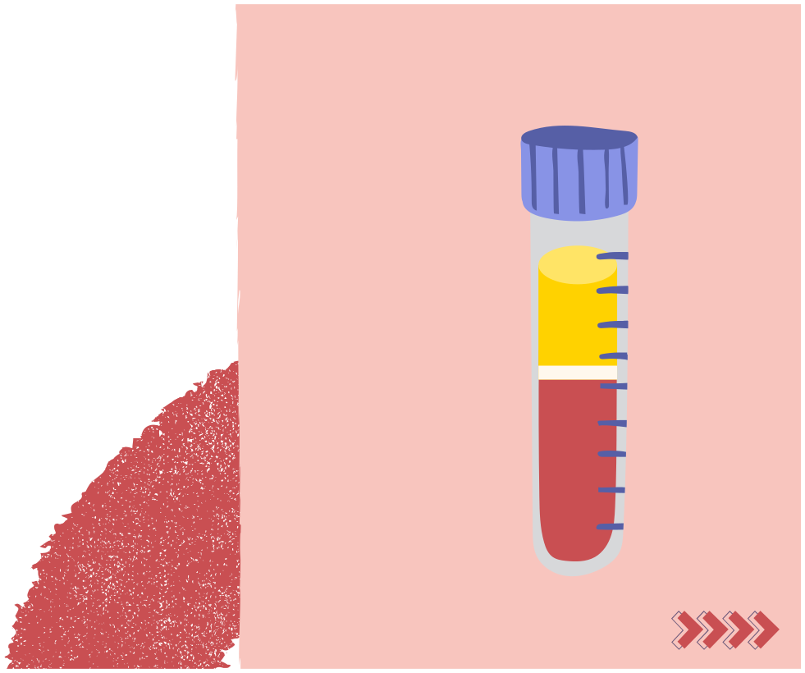
MILESTONE - 2
On the profile page, we can upload the image of the blood sample, and through OpenCV, we can analyze the picture and get the output blood type through few conditions

Slide 10

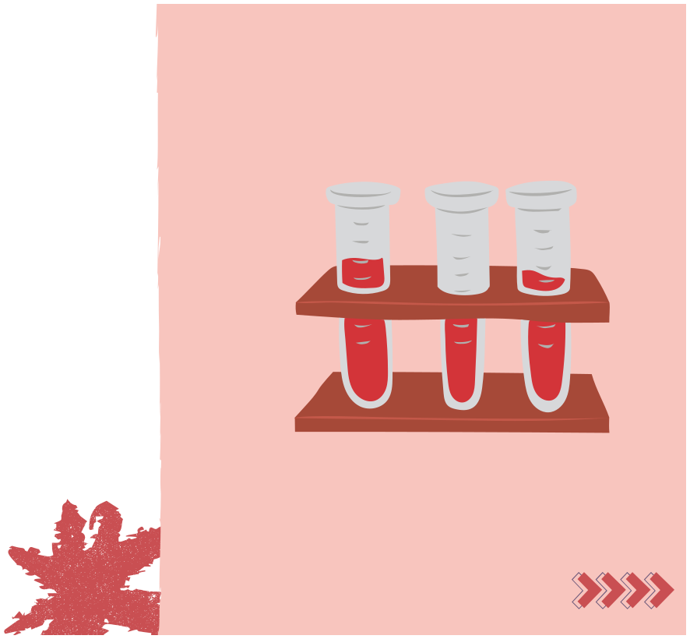
MILESTONE - 3
Upon uploading the image, the website displays the contour length of the blood cell, which helps us in determining the blood type

Slide 11

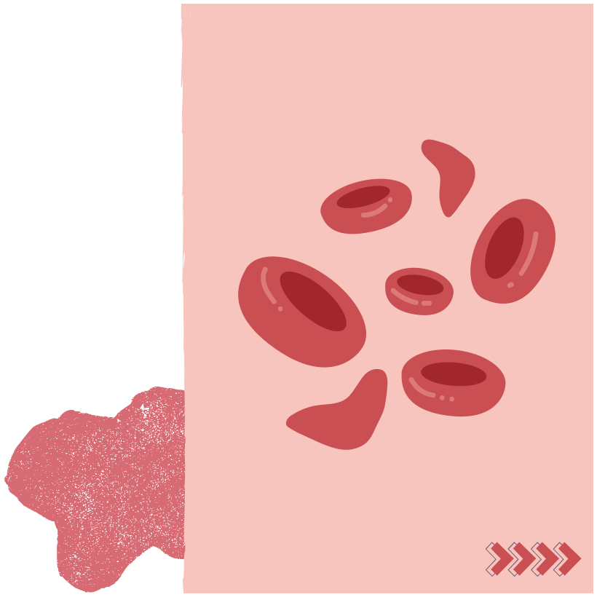
MILESTONE - 4
Displays the uploaded image, processes it into a morphological image highlighting key features, and detects the blood group

Slide 12



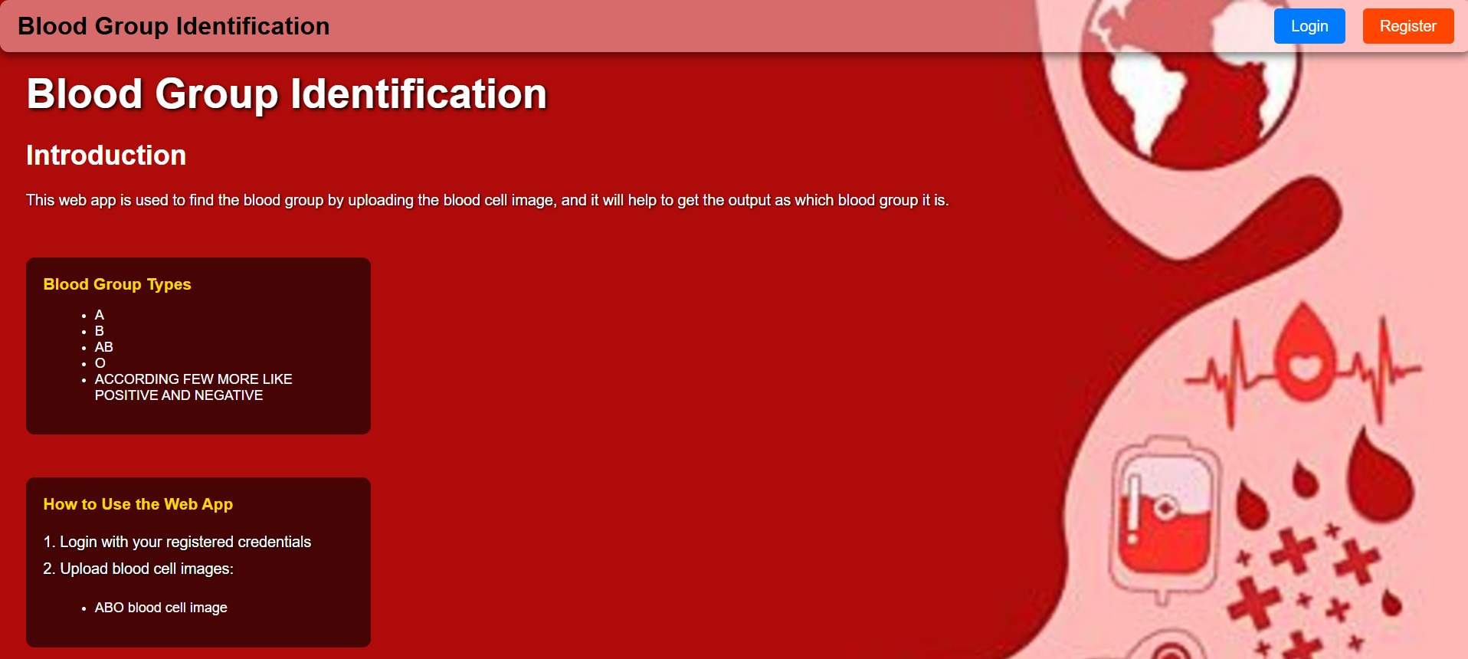
HOME PAGE SCREENSHOT
The landing page introduces the application, showcasing its purpose and user-friendly design.

Slide 13


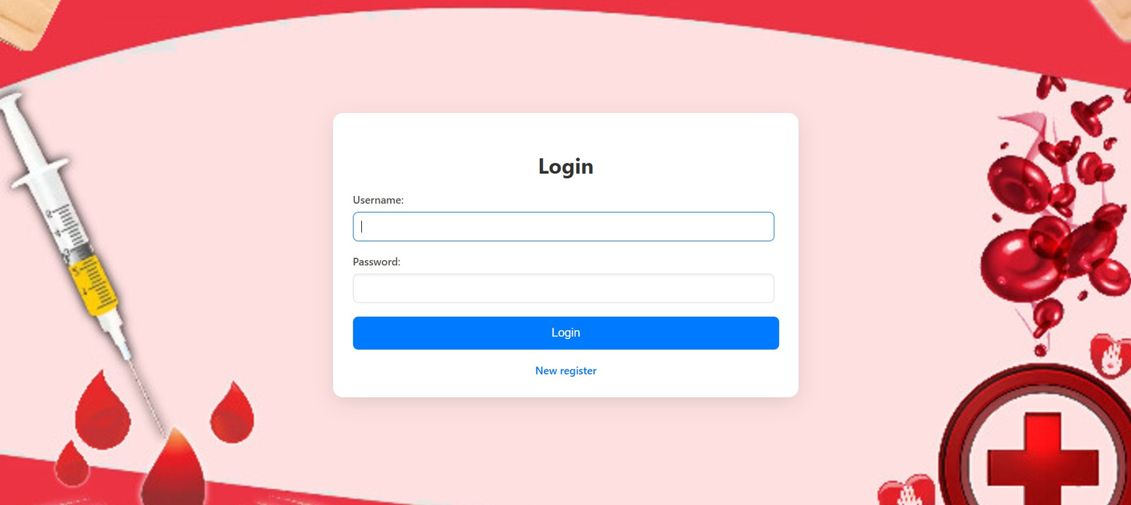
LOGIN PAGE SCREENSHOT
Users can securely register and log in to access features.

Slide 14


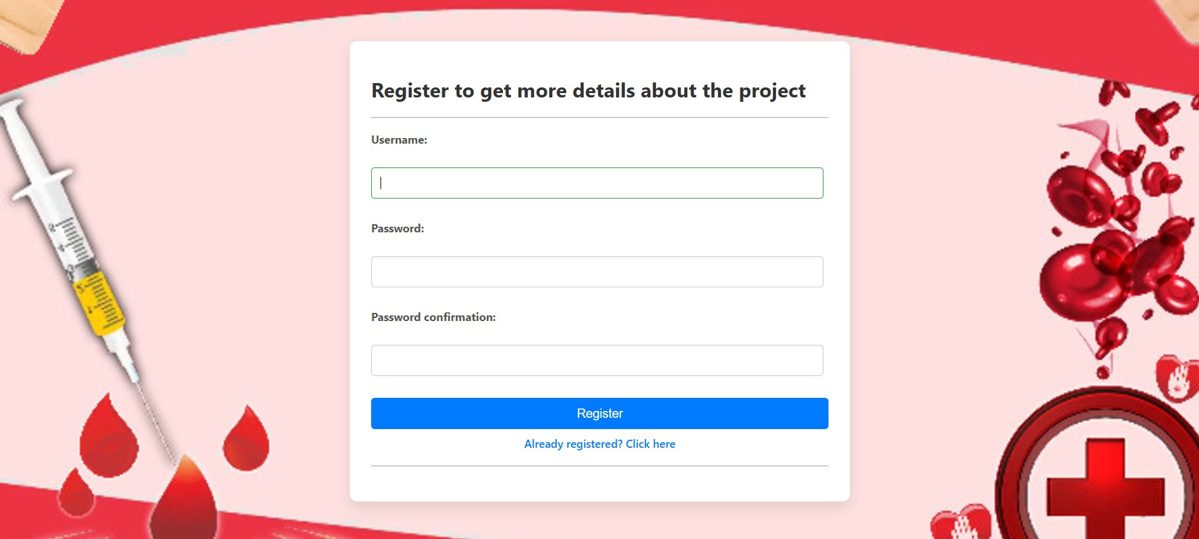
REGISTRATION SCREENSHOT
Users can securely register and log in to access features.

Slide 15


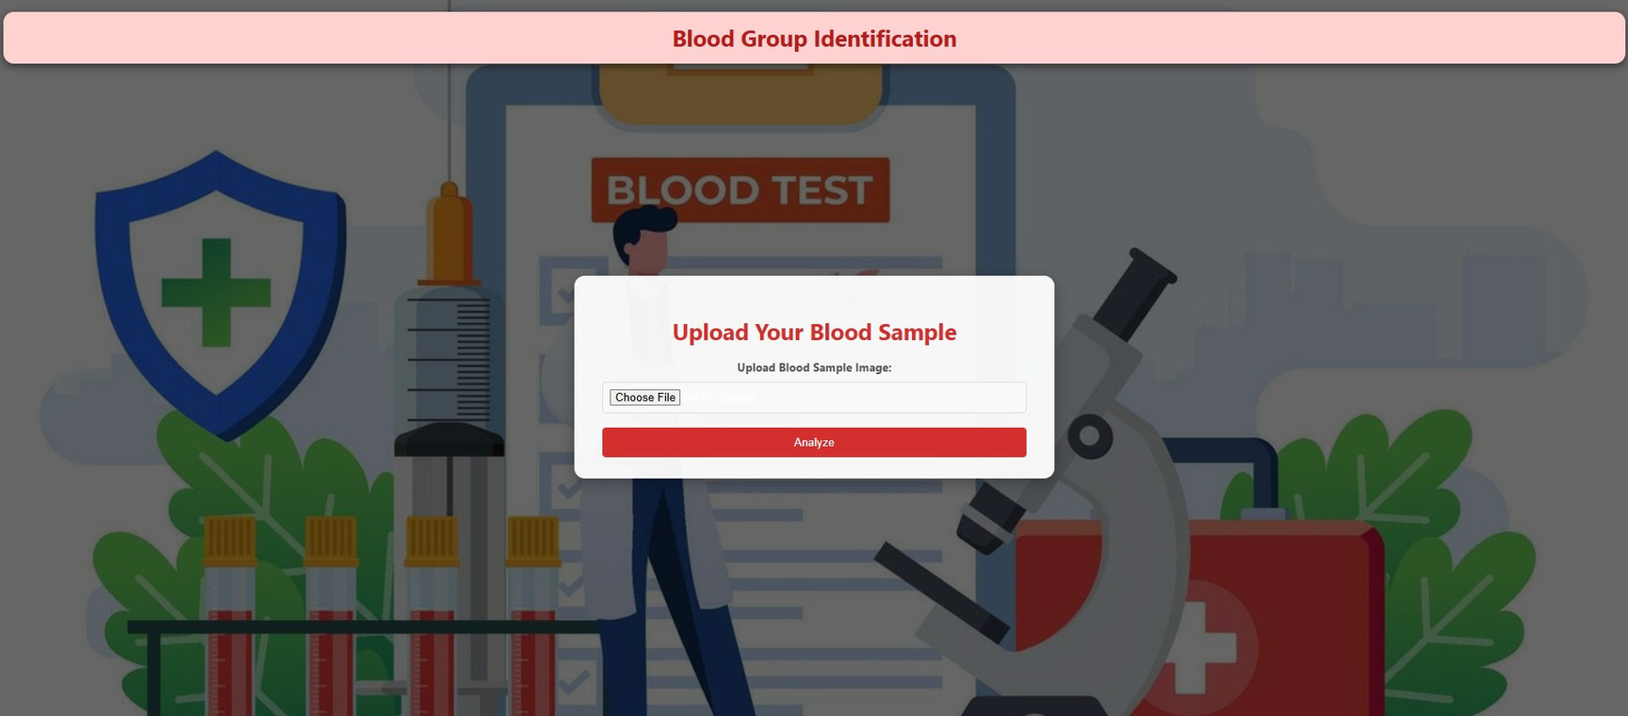
PROFILE PAGE SCREENSHOTS
profile page UI

Slide 16


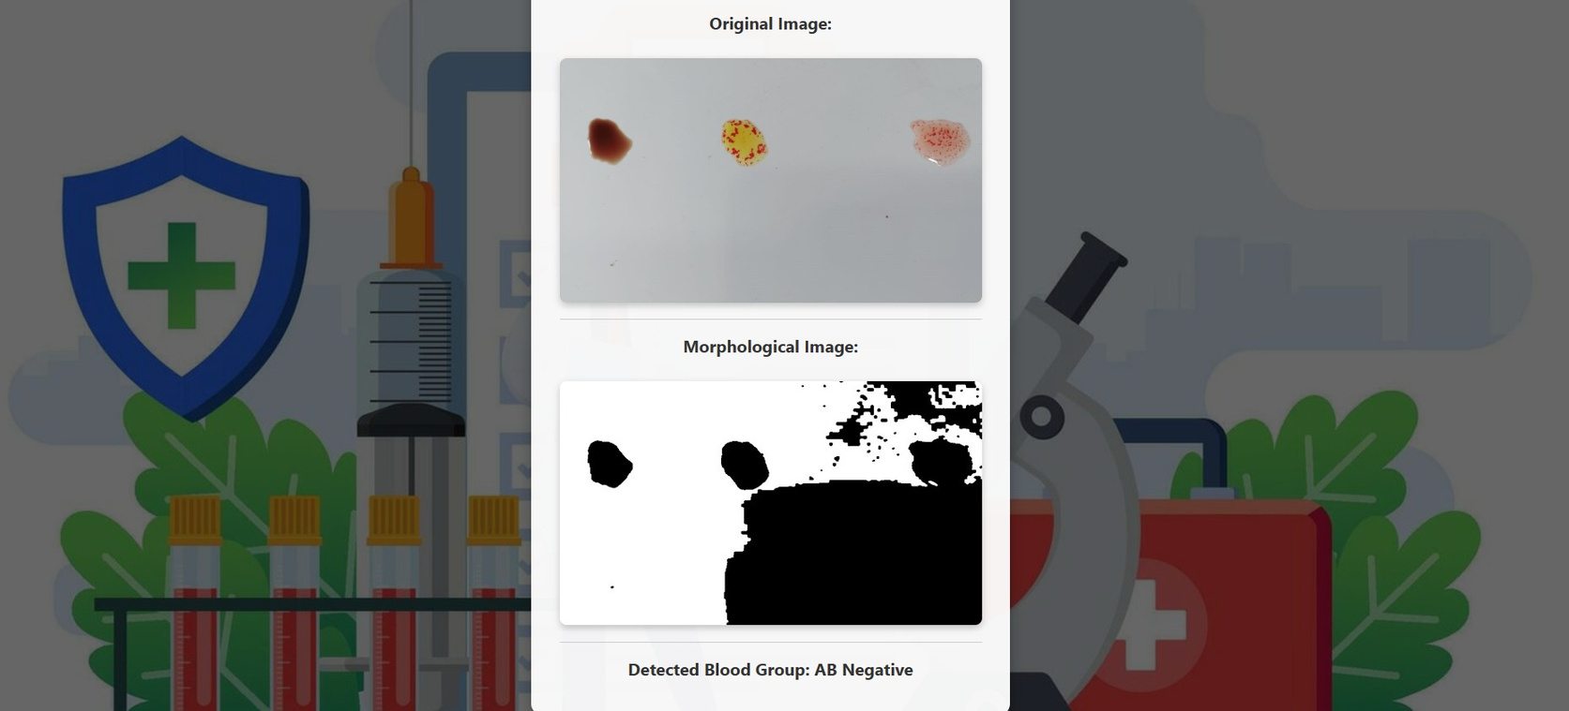
INPUT AND OUTPUT SCREENSHOTS
Users upload images and view detailed results.

Slide 17

Overview of functionality and real-time blood group detection.
LIVE DEMO

Slide 18


CONCLUSION
The Blood Group Identification System successfully integrates computer vision technology using OpenCV to analyze blood sample images and determine the corresponding blood type. Key features include: - User-friendly website with About, Registration, and Login pages - Profile page for uploading blood sample images - Automated image analysis using OpenCV - Accurate blood type determination through predefined conditions - Displays the uploaded image, processes it into a morphological image highlighting key features, and detects the blood group
Milestones Achieved:
1. Development of user interface and registration/login functionality
2. Integration of OpenCV for image analysis and blood type determination 3. Function which calculates and displays the contour length of the blood cells
from the image uploaded by the user.
4.Displays the uploaded image, processes it into a morphological image
highlighting key features, and detects the blood group

Slide 19



TEAM MEMBERS
Ande Gayathri
Utkarsh Khotele
Vinit Dey

Slide 20

Thank You

